Slide 1

Introduction

Slide 2
Intro
Intro
Computation Graph
Gradients
Parallelization

Slide 3
Intro
Intro
Computation Graph
Gradients
Parallelization

Slide 4
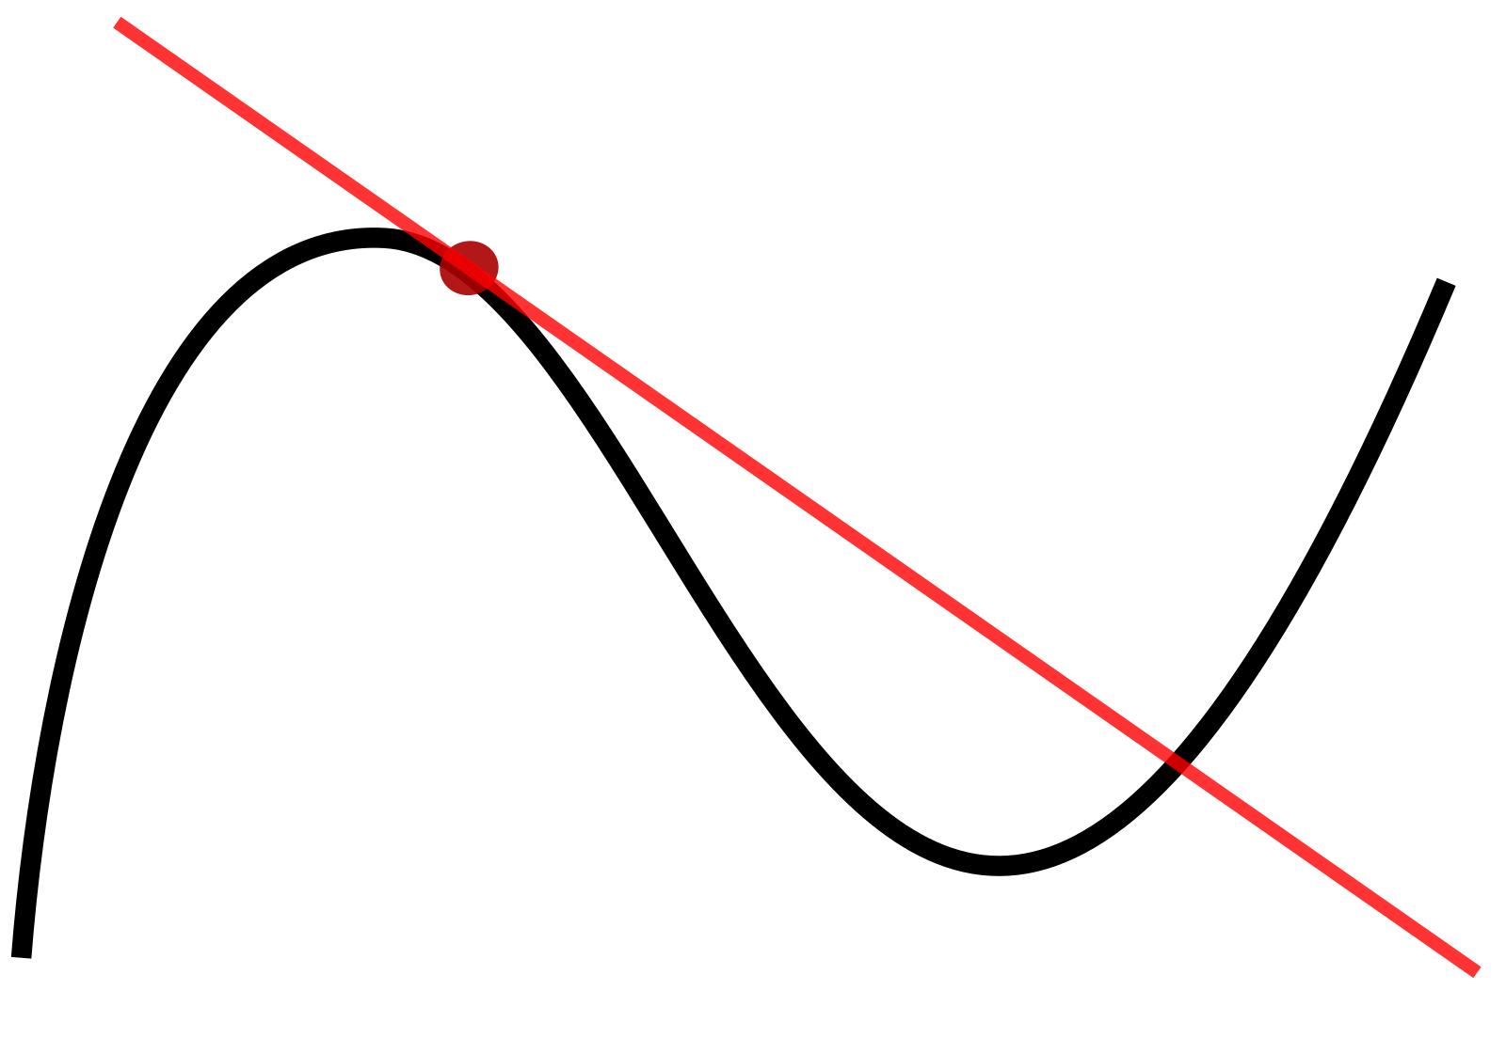
Intro
Tensorflow (TF)
Machine Learning (ML) Framework
Numeric Computation Framework
Plethora of Numeric Functions and Algorithms
Computes Gradients (analytically & automatically)
Helps with Parallelization & Distribution
(CPU, GPU, Compute Clusters, …)
Executable on many Platforms
(Android, iOS, Browser, ...)

Slide 5
Intro/Overview
Steps of using TF:
Create Numeric Program
(Compuation Graph)
Run Program (in a Session)
  Train/Optimize (optional)
  Test/Execute
Compile to Binary (optional)

Slide 6
Computation Graph
Intro
Computation Graph
Gradients
Parallelization

Slide 7
Computation Graph
Consists of:
Constants: Unmodifiable computation input
Variables: Re-assignable, stored in Session,
used for configuration & training
Placeholders: Must be specified every run,
comparable to (named) function parameters
Operations
  Functions: sin, cos, … (recursion possible)
  Control Flow: (loops, conditional, …)
2
var a
y
*
+

Slide 8
Computation Graph/Operations
Operations may be stateful
Ports:
  Inputs and Outputs of Operations
  1 ≤ ports per operation
  Control ports for synchronization
Tensors:
  Data flowing between ports
  N-dimensional arrays of values (float, int, complex, …)
  Similar to NumPy arrays
Computation Graph is combined Control- & Data-Flow Graph
( iss.ices.utexas.edu/Publications/Papers/ICPP1990b.pdf )
+
in:0
sum:0
in:1

Slide 9
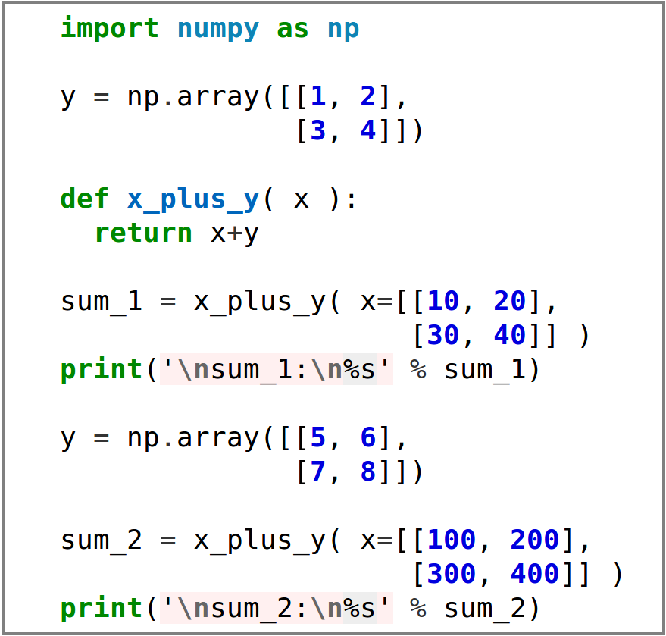
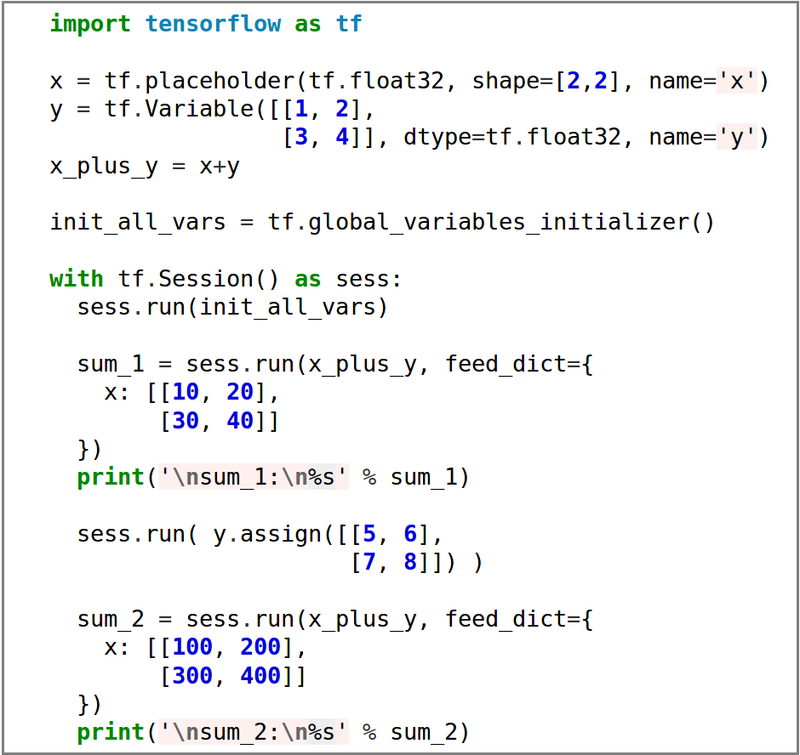
Intro/Example
NumPy
Tensorflow
Graph Creation
sum_1:
[[11 22]
[33 44]]
sum_2:
[[105 206]
[307 408]]
Execution

Slide 10
Gradients
Intro
Computation Graph
Gradients
Parallelization

Slide 11
Gradients/Application
Optimization & Equation Solving is ubiquitous
  ML: Training ≙ Loss Function Minimization
  Engineering: Stiffness Maximization, …
  Finance: Cost Optimization, …
Most Problems non-linear
  Iterative solution (Newton, BFGS, …)
  Usually requires derivative/gradients
  Approximation (Finite Differences) slow and imprecise
  TF computes gradients quickly and precisely
  (Using Back Propagation)

Slide 12
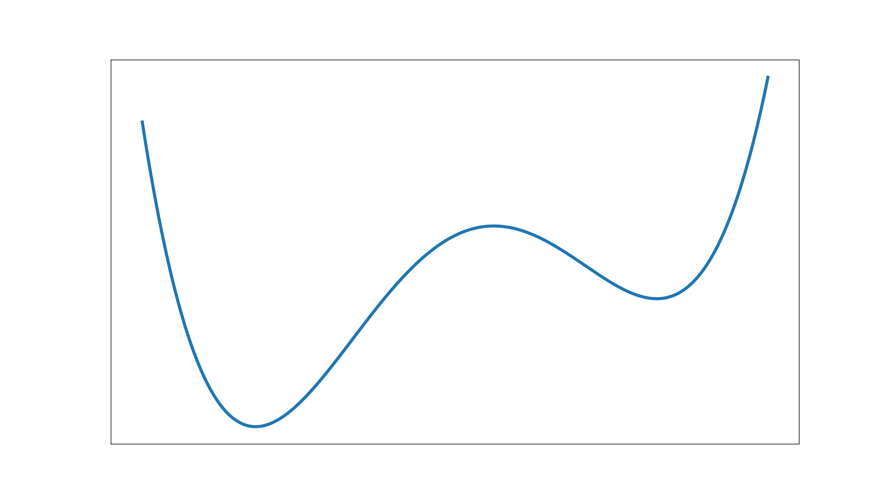
Gradients/Application
p_start
Local Min.
Global Min.

Slide 13
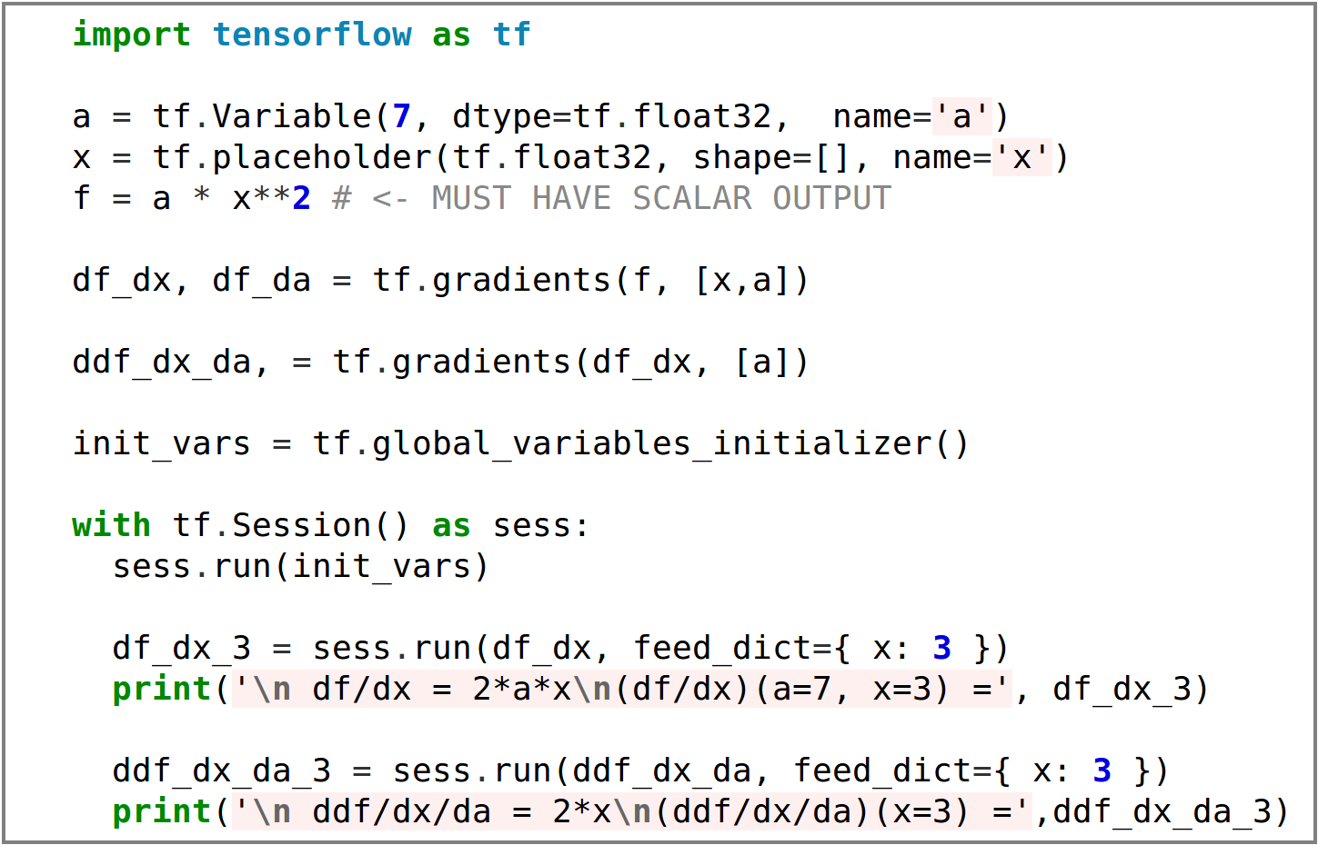
Gradients/Example
df/dx = 2*a*x
(df/dx)(a=7, x=3) = 42.0
ddf/dx/da = 2*x
(ddf/dx/da)(x=3) = 6.0

Slide 14
Parallelization
Intro
Computation Graph
Gradients
Parallelization

Slide 15
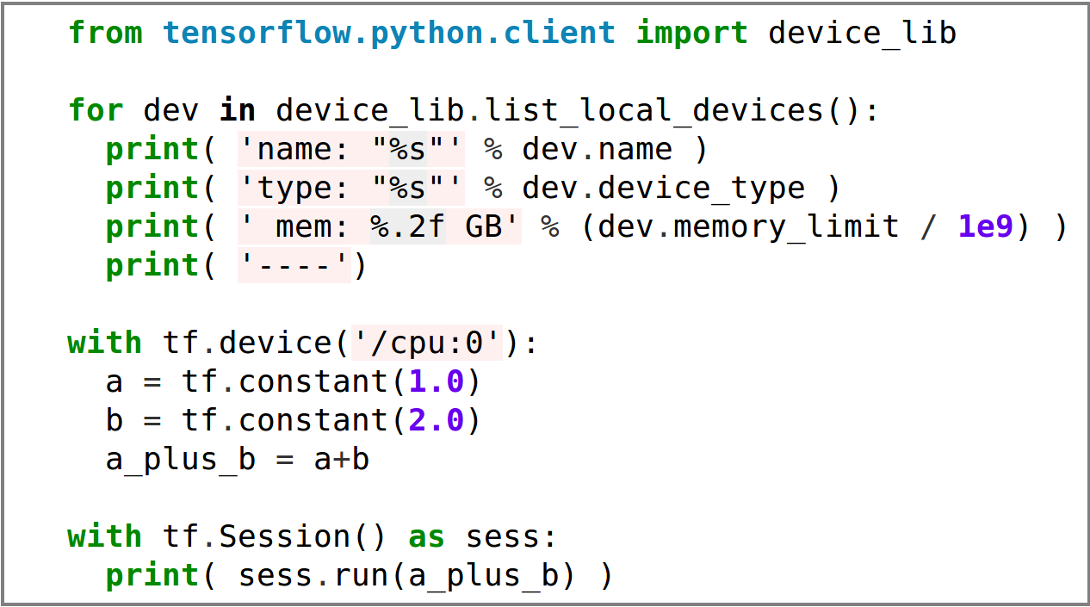
Parallelization
TF automatically parallel
TF guesses best device placement (GPU, CPU, …)
Manual device placement possible
NVIDIA GPU owners: pip install tensorflow-gpu

Slide 16
That‘s it! Questions?
Image source: commons.wikimedia.org

Slide 17
Sources
Tensorflow Logo
http://hilite.me/
(Presenter is in no way affiliated)
Tangent Sketch [Slide 4]:
https://en.wikipedia.org/wiki/Tangent
Python code examples:
http://hilite.me/

